Slide 1

Exploratory Data Analysis
Cab Investment G2M
Luke Andrade
12-13-2022

Slide 2

Agenda
Executive Summary
Problem Statement
Approach
EDA
EDA Summary
Recommendations

Slide 3
Background
XYZ is a US based private firm that is interested in investing in the cab industry due to market growth and key players in the past few years.
Our objective is to decided which of two cab companies will be the better investment option for XYZ.
To do this, multiple data sets which were provided have been manipulated to be suitable for data analysis.
The analysis was split into 3 parts:
Data Wrangling and Cleaning
Data Analysis
Recommendation

Slide 4
The Data
For this analysis, 4 data sets were used that were all cleaned, manipulated, and joined together
Cab data
City data
Customer data
Transaction data
An assumption that was made about the data is that the dates range from 01/01/2016 to 12/31/2018.
This data also has certain limitations as it was not known how the prices are determined by the companies and the duration of the trip was not made available.

Slide 5
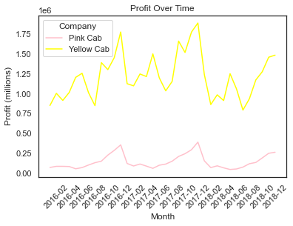
Profit Growth
Stock prices are positively correlated with the profit of the company.
From this graph, we can see that both companies aren’t showing any growth aside from seasonal changes in profit.
This graph also indicates that the best time to invest in Pink Cab and Yellow Cab would be in April and June respectively as that is when the profits are at a low.
Similarly, the best time to sell would be in November for both companies.

Slide 6
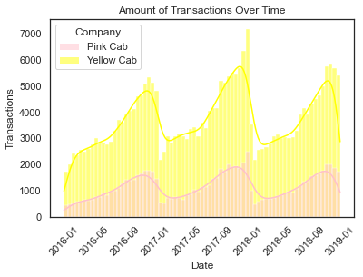
Transaction Growth
The amount of transactions follows the same trend as profit. There is no overall growth aside from seasonality.

Slide 7
City Growth
+------------------------------------------------------------------------------------------------------------+
|Company |Year | States |
+------------------------------------------------------------------------------------------------------------+
|Pink Cab |2016 |[ GA, TX, MA, IL, CO, CA, FL, TN, NY, CA, AZ, PA, WA, DC]|
|Pink Cab |2017 |[ GA, TX, MA, IL, CO, CA, FL, TN, NY, CA, AZ, PA, WA, DC]|
|Pink Cab |2018 |[ GA, TX, MA, IL, CO, CA, FL, TN, NY, CA, AZ, PA, WA, DC]|
|Yellow Cab |2016 |[ GA, TX, MA, IL, CO, CA, FL, TN, NY, CA, AZ, PA, WA, DC]|
|Yellow Cab |2017 |[ GA, TX, MA, IL, CO, CA, FL, TN, NY, CA, AZ, PA, WA, DC]|
|Yellow Cab |2018 |[ GA, TX, MA, IL, CO, CA, FL, TN, NY, CA, AZ, PA, WA, DC]|
+------------------------------------------------------------------------------------------------------------+
This chart shows that in 2016 – 2018, both companies have operated in the same 14 cities. They haven’t expanded into other cities.

Slide 8
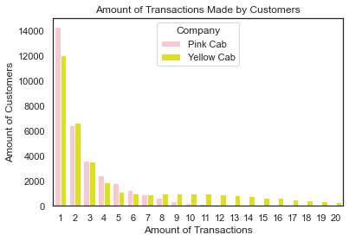
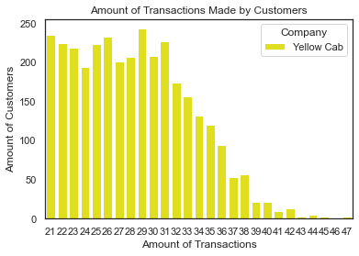
Customer Retention
We can see that Yellow Cab customers tend to go back to Yellow Cab for future rides.
Pink Cab customers don’t exceed 11 transactions while Yellow Cab customers can have upwards of 4.
This could be an indication of great customer service with Yellow Cab

Slide 9
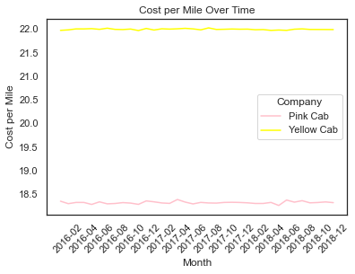
Efficiency
The cost per mile is greater for Yellow Cab than it is for Pink Cab.
This could indicate that Pink Cab uses vehicles that are more gas efficient resulting in lower prices.
This also means that Pink Cab is more environmentally friendly than Yellow Cab.

Slide 10
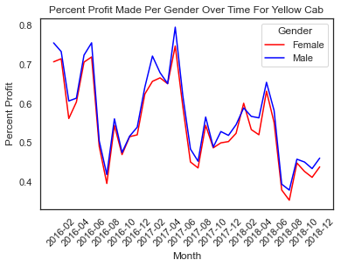
Gender Bias
From this graph, we can see that Yellow Cab tends to charge Male customers more money than Female customers.
Since this is percent profit, it is independent of other factors such as trip duration.
This conclusion is supported by the statistical method ANOVA.

Slide 11
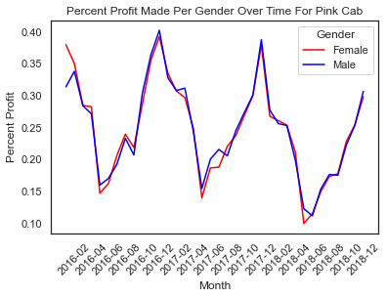
Gender Bias
On the other hand, Pink Cab does not show any clear difference in price charged between the genders.
This conclusion is also supported by the statistical method ANOVA.

Slide 12
Recommendation
Main Points:
Both companies show no profit growth
Both companies showed no customer growth
Both companies aren’t expanding their business to other cities
Yellow Cab has better customer retention
Pink Cab has better vehicle efficiency so is more environmentally friendly
Yellow Cab displays gender bias in their pricing which is a risk factor
Both companies show seasonality in profit which indicates potential stock buying and selling periods.
Based on the analysis, I believe it would be wiser to research other companies as well since these two haven’t shown the best growth potential.
Out of the two, Pink Cab seems like the better choice as it is more environmentally friendly, cost efficient, and doesn’t have the gender bias risk factor that Yellow Cab has.
The best time to buy Pink Cab shares is around April and the best time to sell is around November

Slide 13
Thank You

